Slide 1
LINQ Language Integrated Query Chapter 17 LINQ to SQL
Book: ADO.NET 4 C#
© 2011, Mike Murach & Associates, Inc.

Slide 2
Think of the object model as a set of business classes that define business objects that are directly related to the tables (or views) in the database.
We will need to define this model for each program.
Your code will operate on the object model (reading or writing), the runtime will do the magic over to the database
Notes:
2

Slide 3
Yep, another way of specifying the same things!
(like a DataAdapter?)
(like a DataSet?)
(DataSet.CarID ?)
Notes:
3

Slide 4
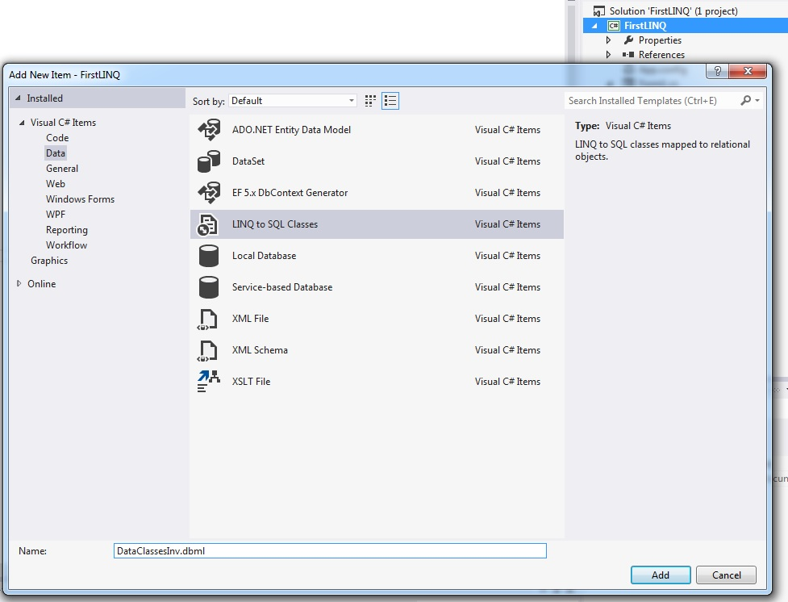
Creating an Entity Class with the Object Relational Designer
O/R Designer
DataClassesOrderDetail.dbml

Slide 5
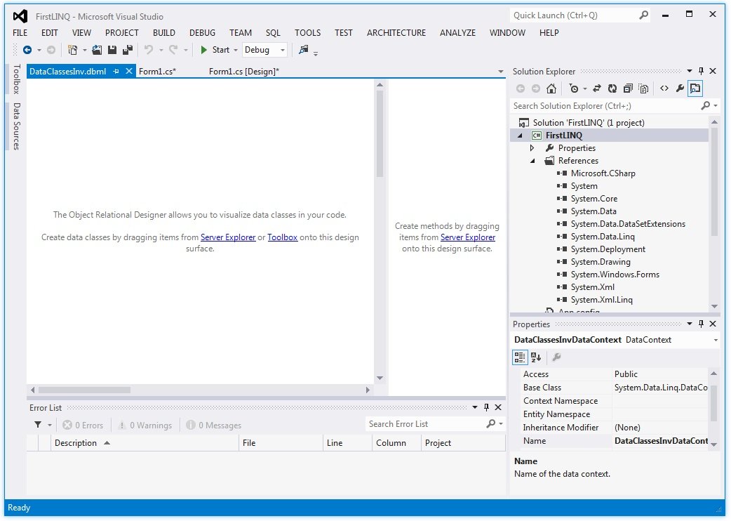

Slide 6
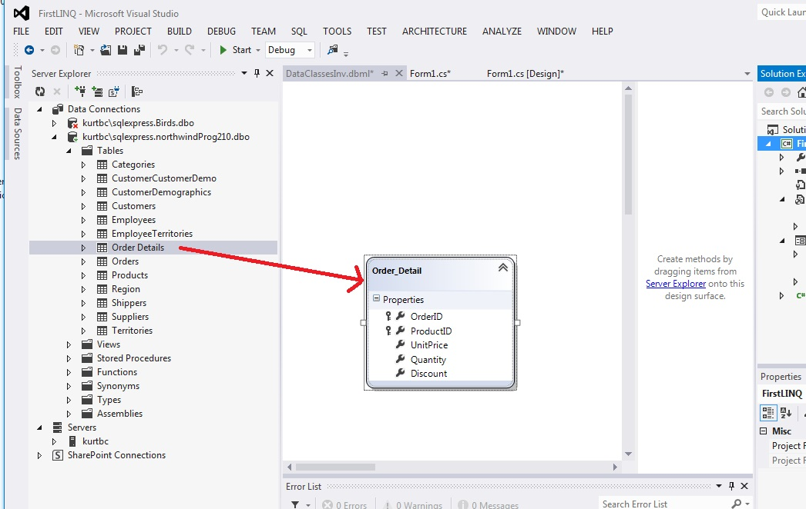
Order Details => Order_Detail (by default, the O/R designer tools drops the s off the names of items and makes them singular. You can change the default.)
Doing this automatically creates
The “connection string” for us
In the App.config file.

Slide 7
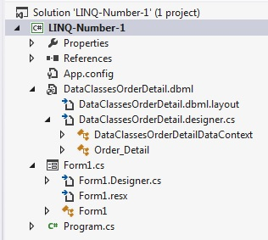
Our Object Model is built for us:
Data context
Entity Class

Slide 8
This new class
Is created for us
Includes properties to refer to each column in that table (using the same names)
Also adds a property to the data context class that refers to the table (Order Details)
If you drag in 2 tables that have a relationship, then the O/R designer will create an Association object to maintain those constraints. (see next slide for example)
We now have a C# class view of a table, its columns, and any PK-FK relationships.

Slide 9
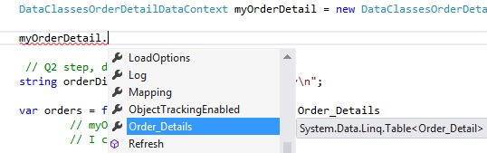
Using Intelisense …
My Data Context object has a property that is my DB table name.

Slide 10
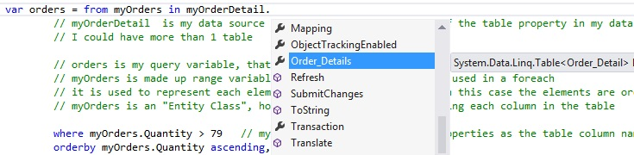
Using that table name myOrderDetail.Order_Details
myOrders is made up range variable name
(much like when we do a foreach, for each string item in blah)
A local range variable that represents each element in the source sequence. (in our case, a row from the SQL table, but could also be an XML element)
myOrders is an "Entity Class", holding Class members, 1 for each each column in the original SQL table

Slide 11
Open 2-1-Query-A-OneTable

Slide 12
define the query expression
// Q2 step, define the query expression
// query expression is stored in our variable “orders”, of type query
var orders = from myOrders in myOrderDetail.Order_Details
//Order_Details is the "Entity Class" that represents that table in the DB
where myOrders.Quantity > 79
// myOrders is our made up iterator variable, represents one row at a time
// myOrders object has the same properties as the table column names
orderby myOrders.Quantity ascending,
myOrders.ProductID ascending
select new { myOrders.ProductID, myOrders.Quantity };
// choosing which columns to actually load into this object representation of the table
==========================================================================
select myOrders;
//The other way: no qualification, we want all the data, like a SQL SELECT *

Slide 13
Q3 Execute the query
// that all sets up a differed query, which we will use next
// Q3 Execute the query to return the results
foreach (var orderItem in orders)
// orderItem is just a made up name, orders is our query expression
{
orderDisplay += orderItem.ProductID + "\t\t" +
// first column
orderItem.Quantity.ToString() + "\n";
// second column appended to the string
}

Slide 14
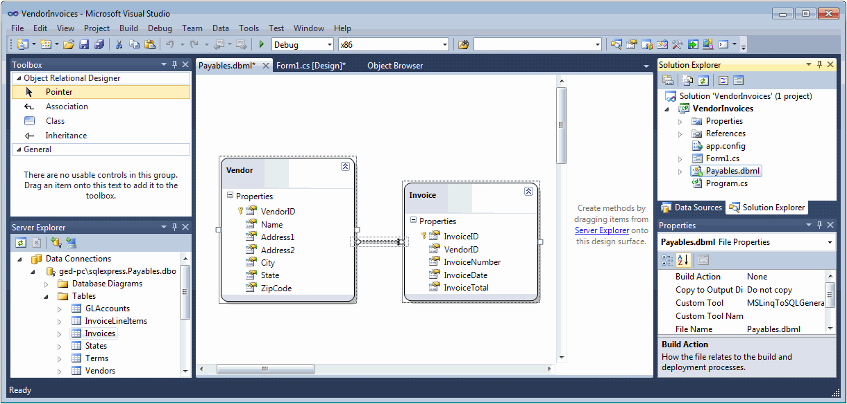
Arrow shows the PK-FK relationship which is a 1 to many
Invoice class will have a property named Vendor that you can use to get that information back that was in the Vendors table (e.g. Vendor.City)
Likewise, the Vendor class will have a property named Invoices that you can refer to the collection of invoices from that vendor
Notes:
14

Slide 15
Make a copy of my program with new name
We will add a second table, Products
We will output the same pop up box, but instead of ProductID, we will show the ProductName
Open the DataClassesOrdDetail.dbml
Open Server Explorer and drag the Products table into the O/R Designer
Notice the arrow, showing the PK-FK so now we can use the ProductID in Orders Detail to get get to the ProductName with the same key in Products
2-2-Query-B-Join

Slide 16
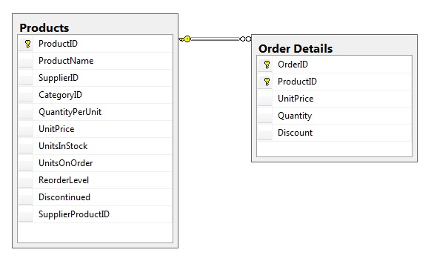

Slide 18
// Q2 step, define the query expression, this time with a join, so we can get the product name
string orderDisplay = "Quantity\t\tProduct\n"; // flipped the order, just cause tabs work better
var orders = from myOrders in myOrderDetail.Order_Details // made up name myOrders
// now add the join
// first, add the 2nd table to the query
join myProducts in myOrderDetail.Products // myProducts is another made up range variable name
on myOrders.ProductID // declare which columns should match in the 2 tables
equals myProducts.ProductID //use of made-up range variable as token for objects in returned list
where myOrders.Quantity > 79 //myOrders object has the same properties as the table column names
orderby myOrders.Quantity ascending
// choosing a new column ( ProductName) from the joined table, Products
select new { myProducts.ProductName, myOrders.Quantity };
// that all sets up a differed query, which we will use next
// Q3 - Execute the query to return the results
foreach (var orderItem in orders) // orderItem is just a made up name, orders is our query expression
{
orderDisplay += orderItem.Quantity.ToString() + "\t\t" + // first col
orderItem.ProductName + "\n"; // second column appended to the string
}
MessageBox.Show(orderDisplay, "> 79 orders Product");

Slide 19
Instead of an overt Join, use the built in Association capability of LINQ
Make a copy of the 2nd program, and change this code:
var orders = from myOrders in myOrderDetail.Order_Details
// no need to do a join, the Association is provided by LINQ-to-SQL based of the PK-FK relationship from the DB
// same code as last 2 versions
where myOrders.Quantity > 79
orderby myOrders.Quantity ascending
// V2 code relying on overt join
select new { myVendors.ProductName, myOrders.Quantity };
// choosing a new column from the joined table, Products
// new code
select new { myOrders.Product.ProductName, myOrders.Quantity };
//can instead just reference it through the Product.ProductName which is
//in myOrders because LINQ pulls in all those fields linked by the PK-FK
2-3-Query-C-Assoc

Slide 20
DataContext class
myOrders.Product.ProductName,
Database Connection information and capability
Products Entity Class (with members that map to fields)
And an Order Details Entity Class (with members that map to fields)
And an Association attribute Product

Slide 21
Now we will crawl through this one
LINQ-InnerJoin-Relationship

